Slide 1
Word Embedding Complex Networks
By: Rohola Zandie
October 2017

Slide 2
Complex Networks: Overview
Very large networks with non-trivial topological features
Networks of thousands, millions and billions of nodes
Internet network
Brain network
Social network: facebook, twitter, real social net’s
Protein-protein interactions
..
They evolve naturally and have universal properties

Slide 3
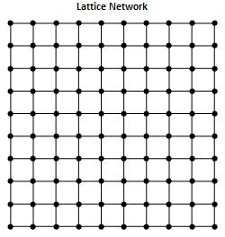
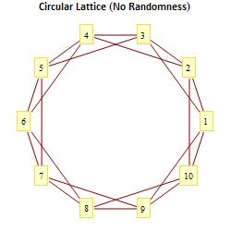
Types of networks
Regular networks
Lattices, Ring, Chain, …
Crystal, Exact Symmetry
Network properties can be calculated analytically

Slide 4
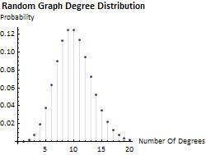
Types of networks
Random networks
Erdos-Renyi Model
Degree distribution: Poisson
Chaotic

Slide 5
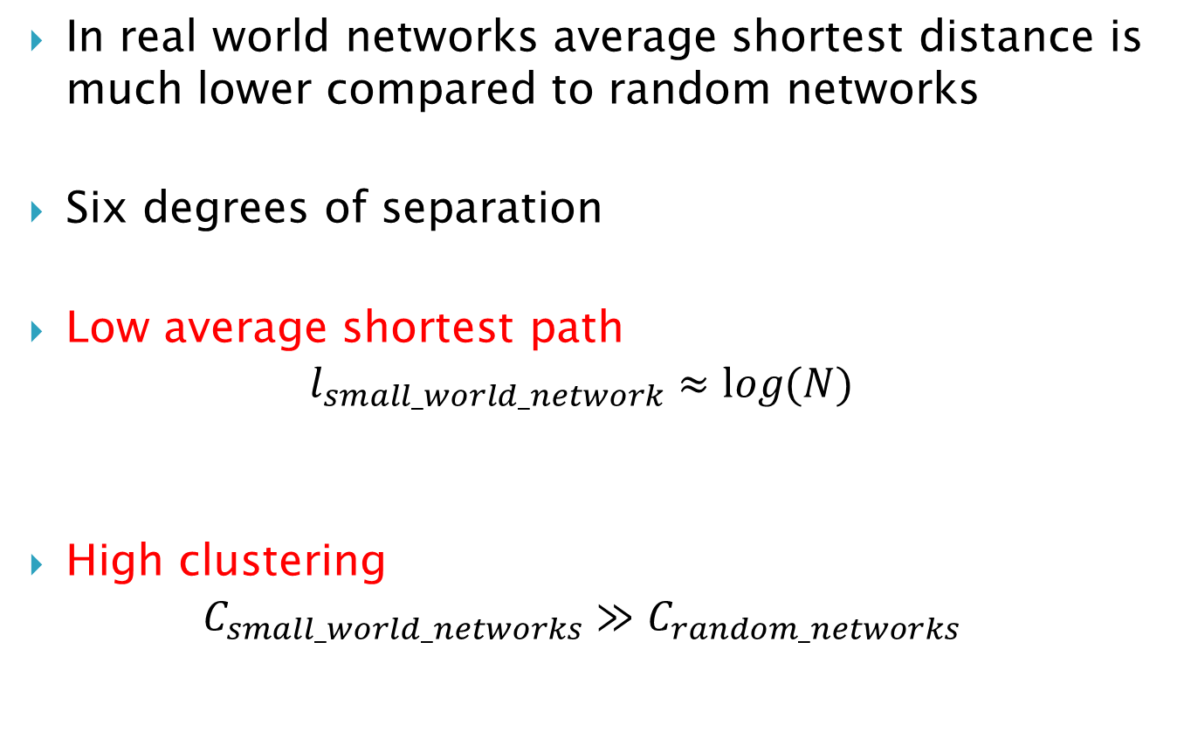
Small-world networks
In real world networks average shortest distance is much lower compared to random networks
Six degrees of separation
Low average shortest path
$$l_{small_world_network}≈log⁡(N)$$
High clustering
$$C_{small_world_networks}≫C_{random_networks}$$

Slide 6
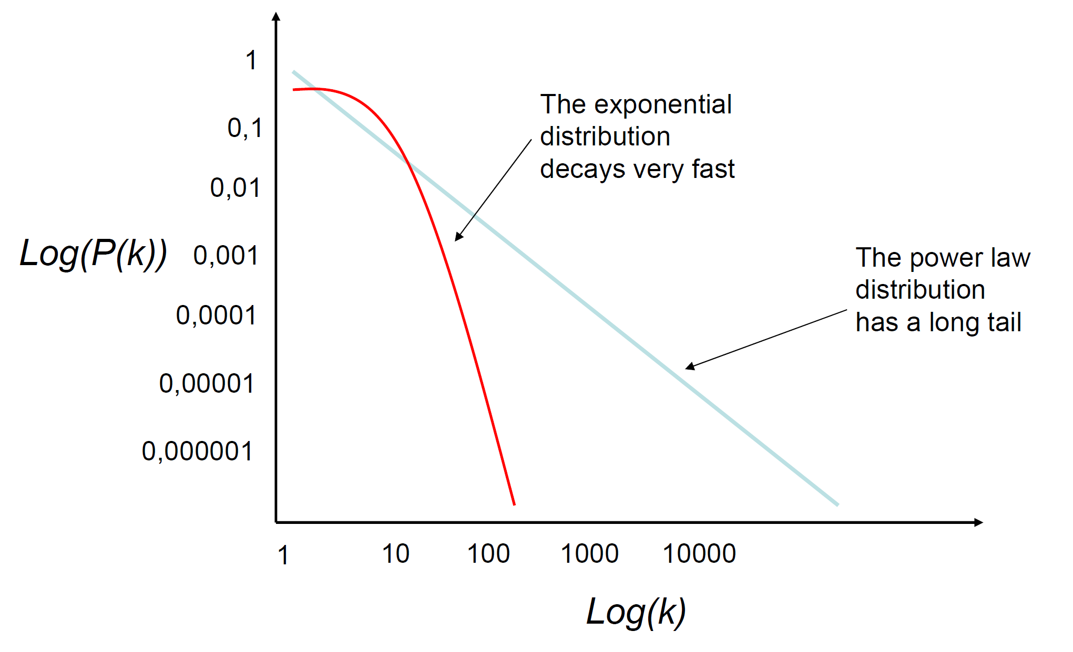
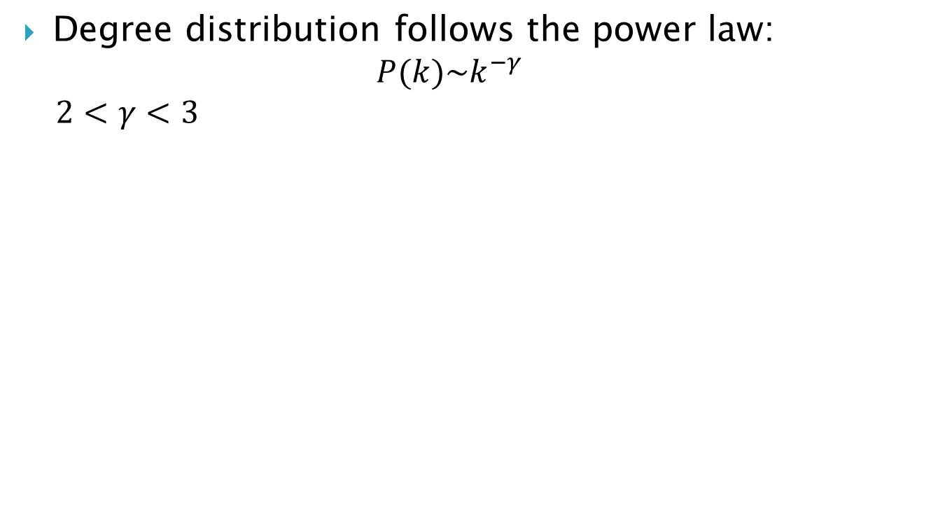
Scale free networks
Degree distribution follows the power law:
$$P(k)\sim k^{−γ}$$
$$2<γ<3$$

Slide 7
Scale free networks Properties
Preferential attachment: High degree nodes have more probability to make new connections
In scale free network, properties of network are preserved independently of the scale.

Slide 8
Scale free and small world
Information flow is faster
Robust to perturbations than other network architectures
Emergent complexity: Small-world properties can arise naturally in real-world systems via the process of dual-phase evolution

Slide 9
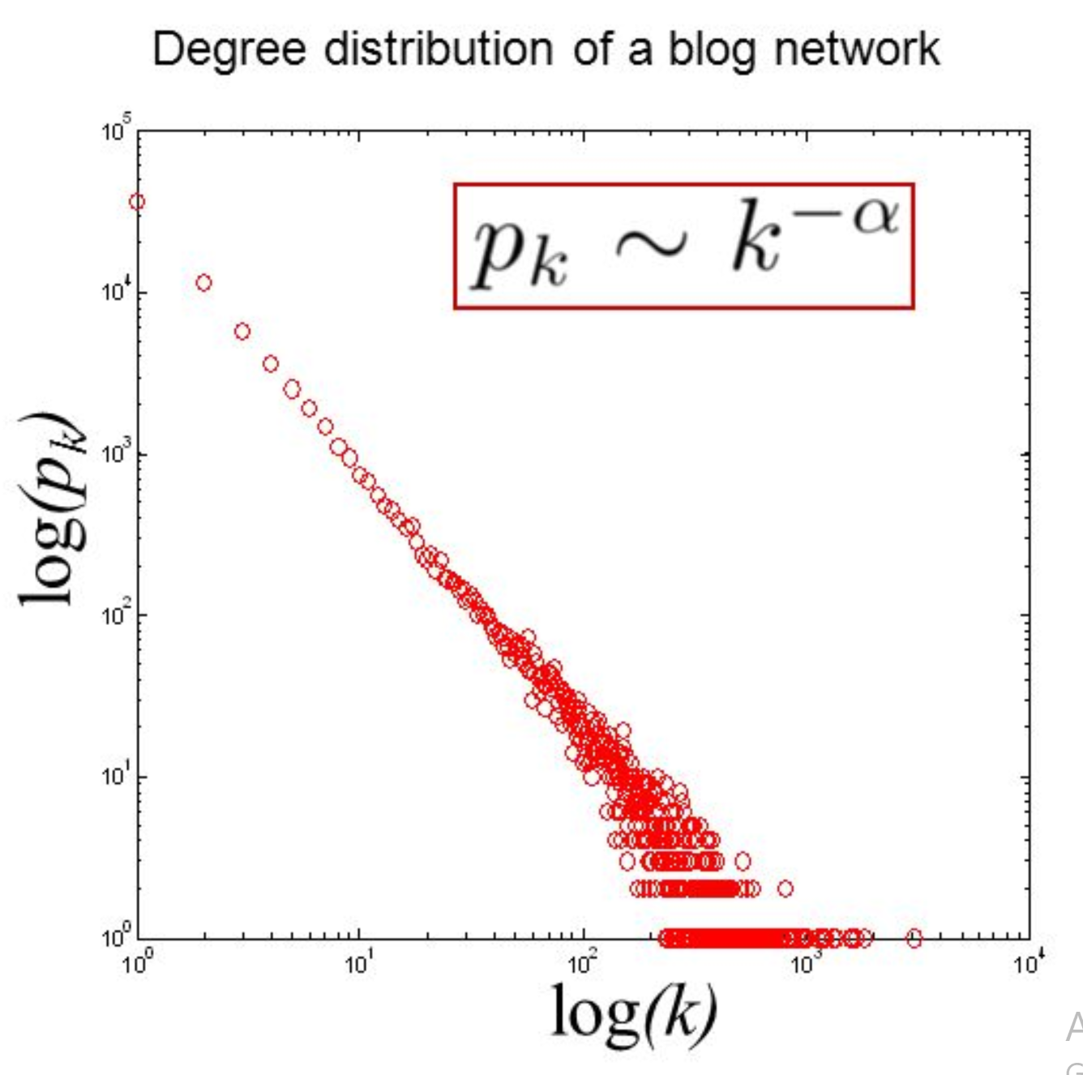
Heavy tail phenomena
Degrees in real networks are heavily skewed to the right

Slide 10
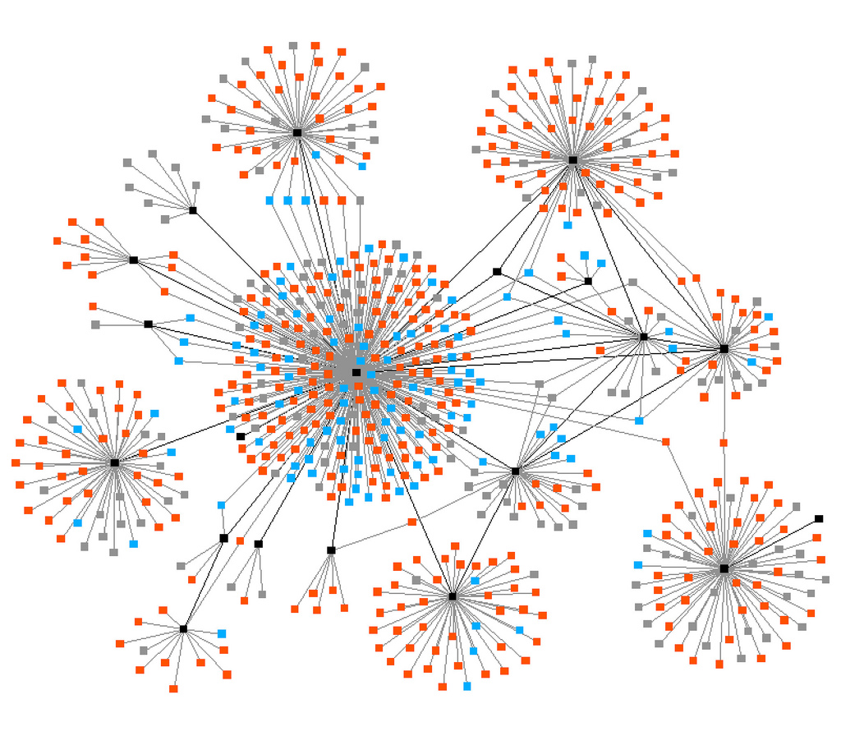
How they look like?

Slide 11
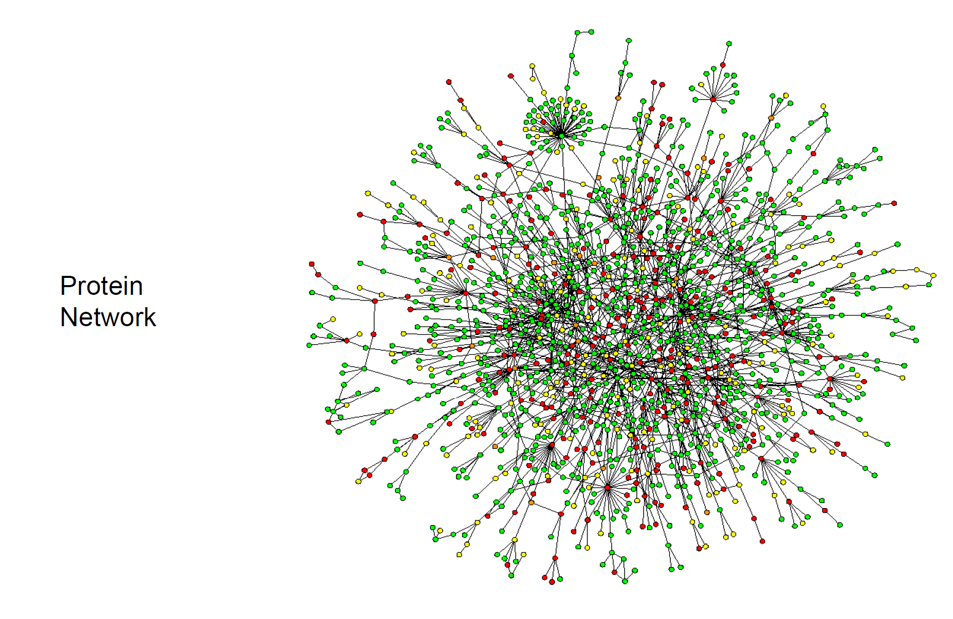
Real world networks

Slide 12
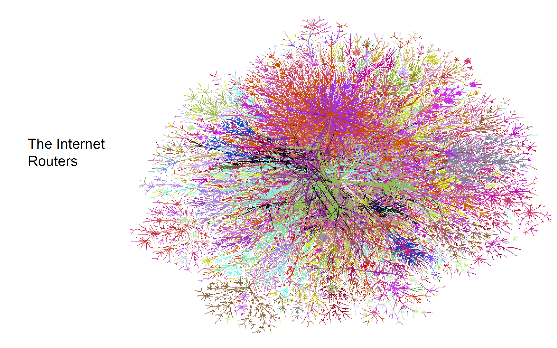
Real networks

Slide 13
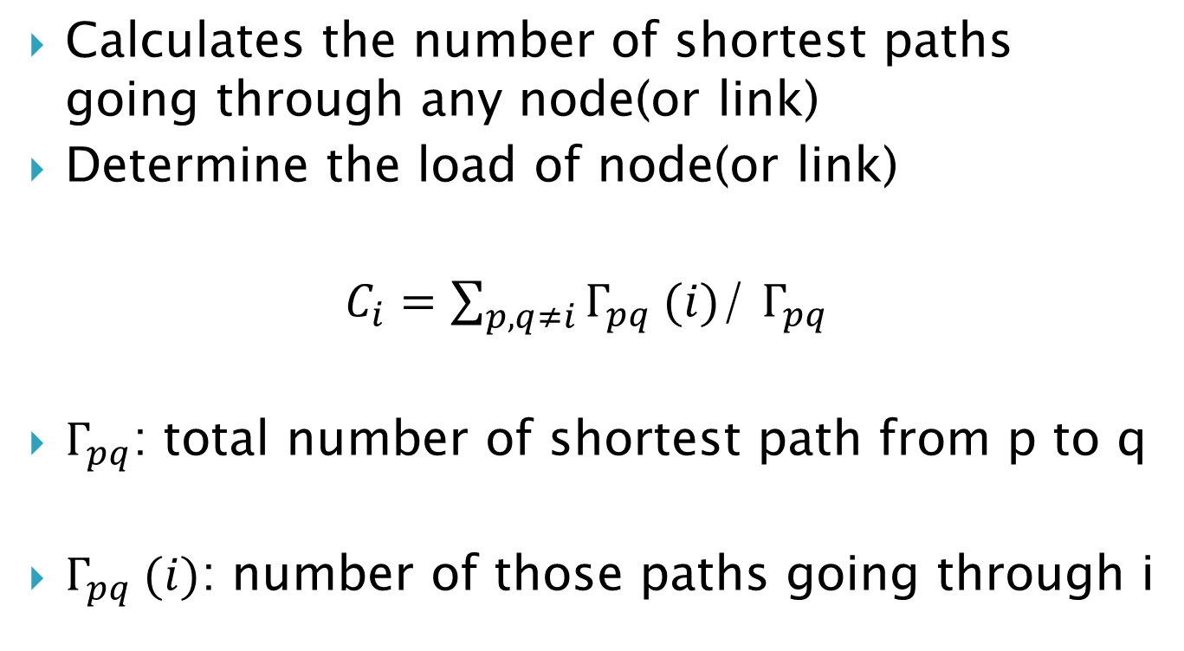
Betweenness Centrality
Calculates the number of shortest paths going through any node(or link)
Determine the load of node(or link)
$C_{i}=\sum_{p,q≠i}{Γ_{pq} (i)}$/ $Γ_{pq}$
$Γ_{pq}$: total number of shortest path from p to q
$Γ_{pq} (i)$: number of those paths going through i

Slide 14
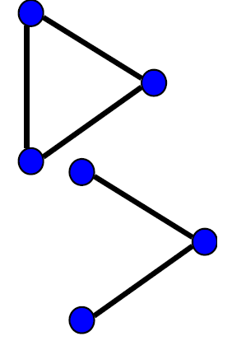
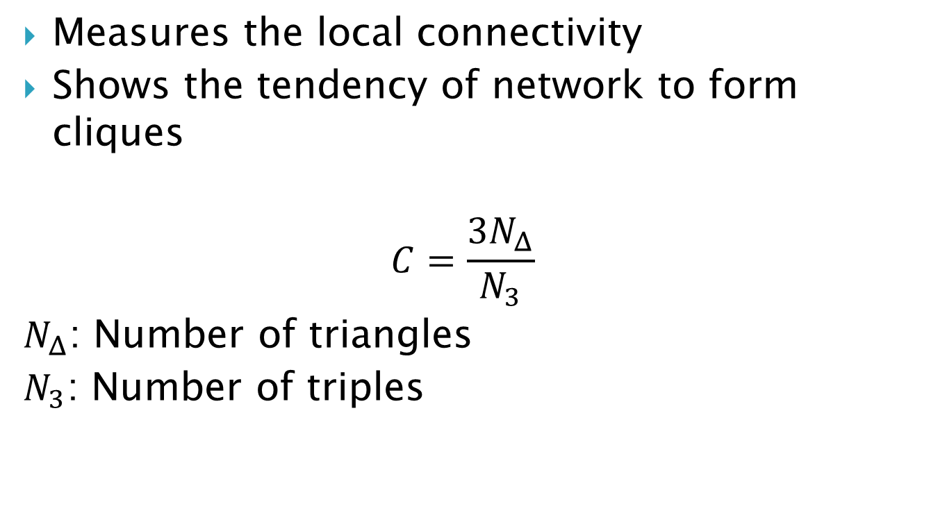
Clustering Coefficient
Measures the local connectivity
Shows the tendency of network to form cliques
$$C=\frac{3N_{Δ}}{N_{3}}$$
$N_{Δ}$: Number of triangles
$N_{3}$: Number of triples

Slide 15
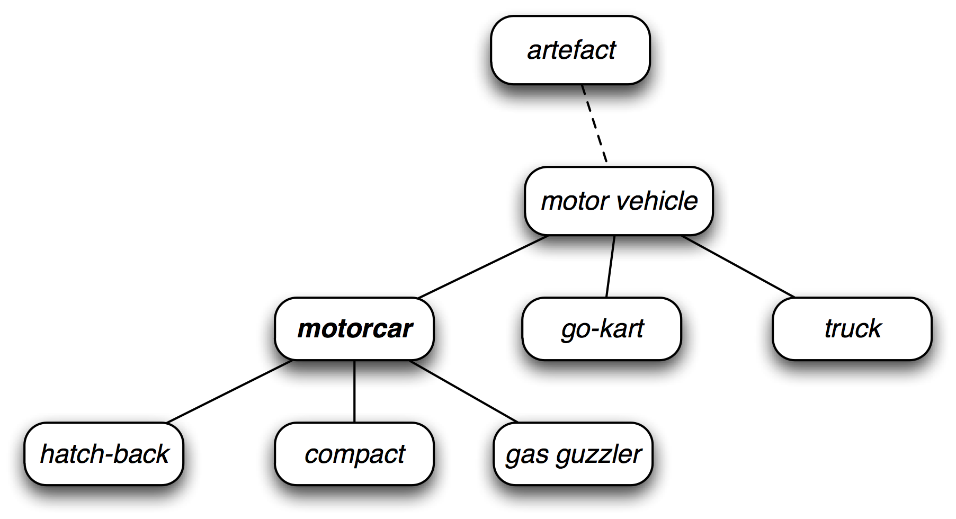
Language networks
Static networks: Constructed by linguists
Nodes can be any language construct: words, morphemes, phonemes
Edges(relationships) hyponymy, antonymy, synonymy,..
Wordnet

Slide 16
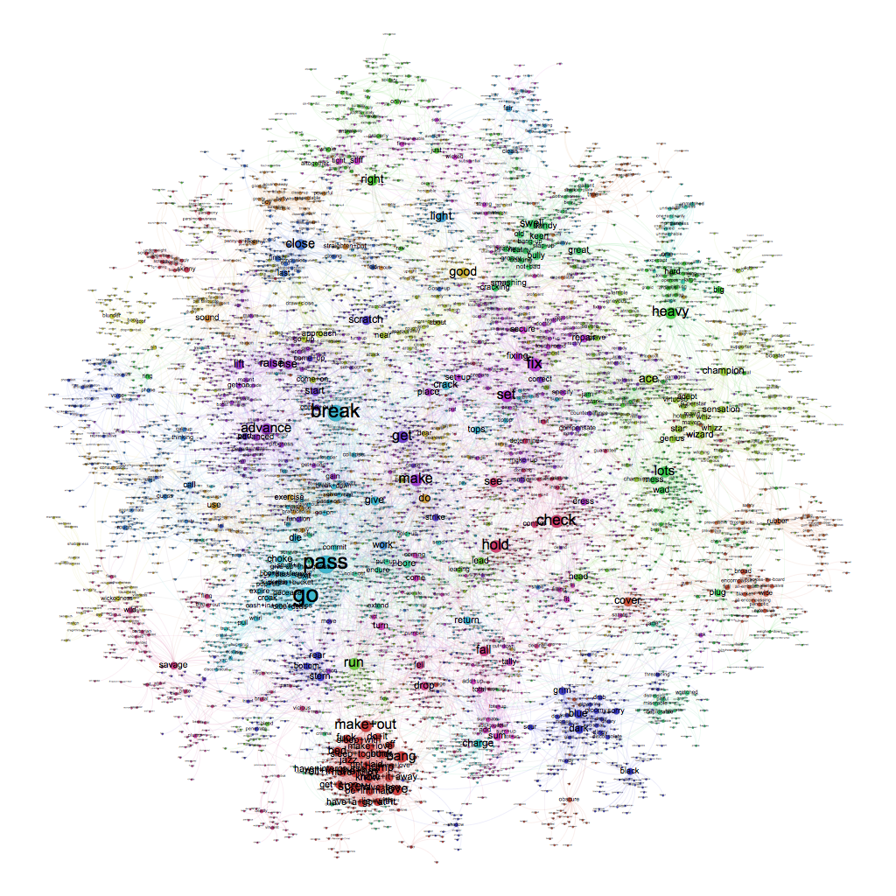
WordNet in bigger scale

Slide 17
Language networks
Dynamic networks: Actual language use
Nodes: Tokens (words not just in dictionaries)
e.g. Moscow, Solomon, Microsoft,..
Edges(relationships): Word co-occurences(in a window), syntactic dependency, Semantic relations
Can reflect the complexity of actual language use!

Slide 18
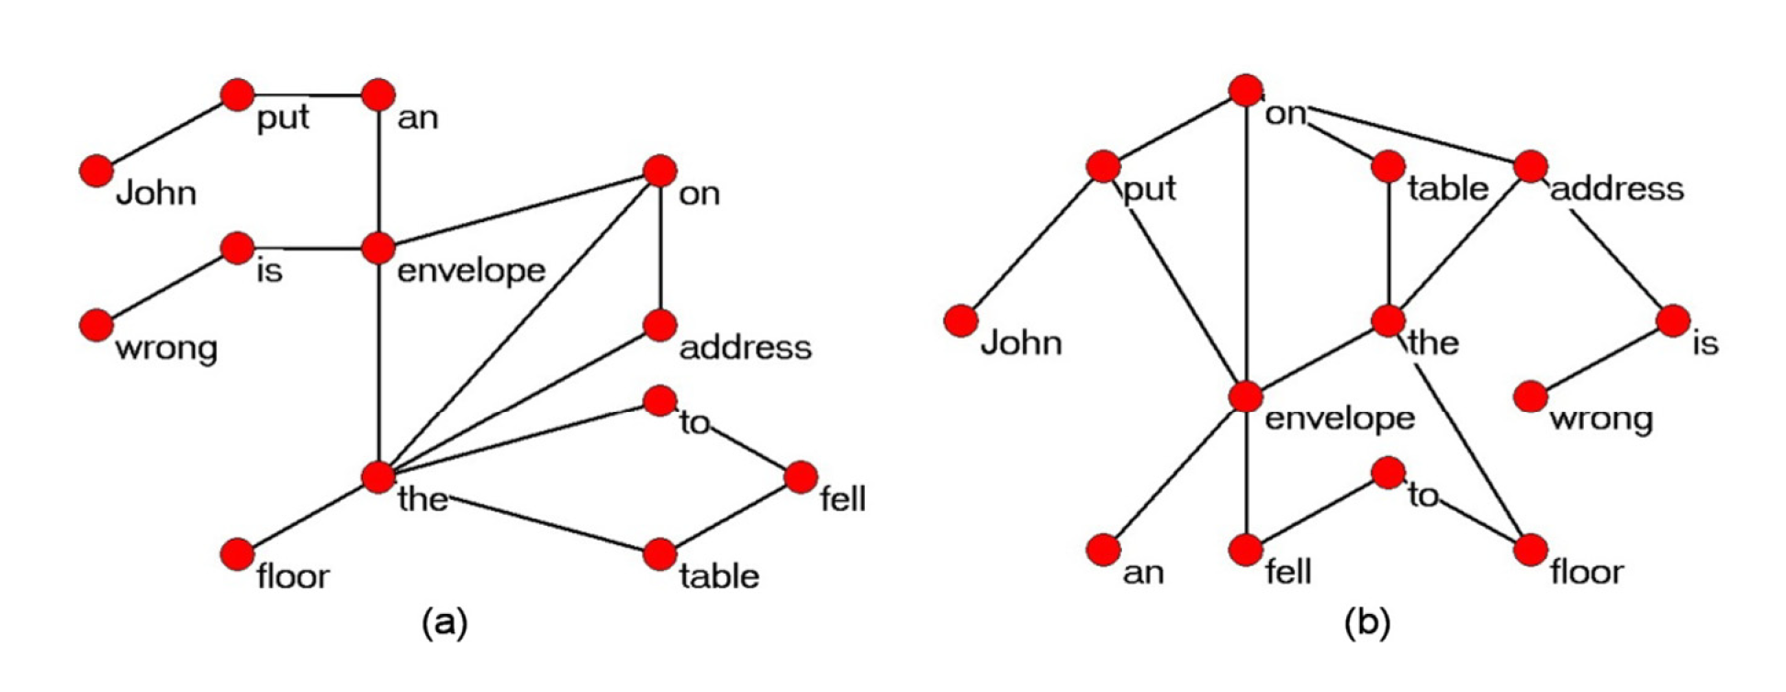
(a) Syntactic dependency net
(b) Word co-occurrence networks

Slide 19
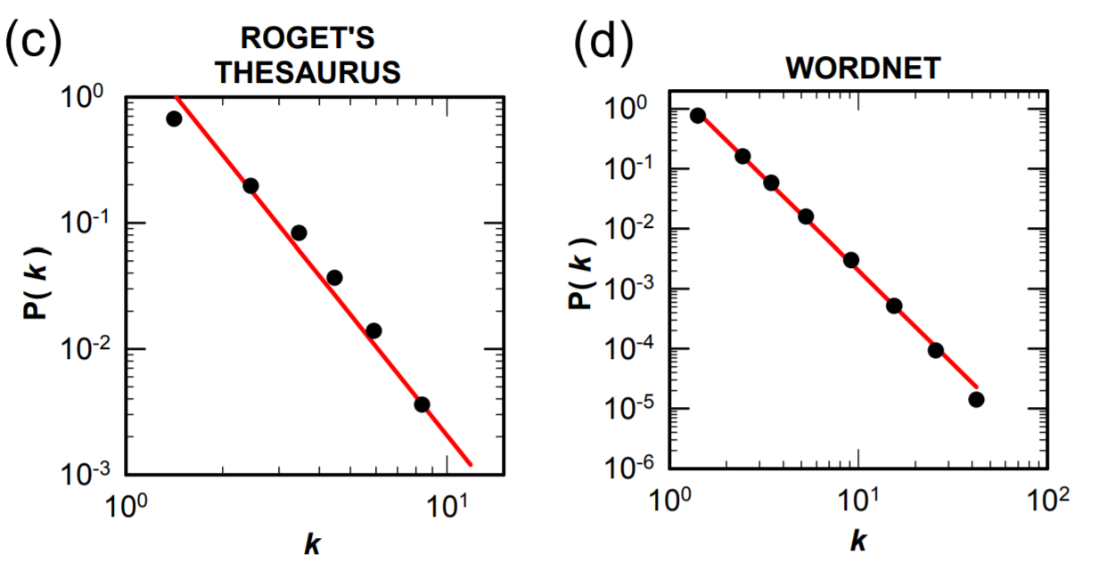
Scale free properties of word networks
Steyvers, M., & Tenenbaum, J. B. (2005). The Large‐scale structure of semantic networks: Statistical analyses and a model of semantic growth. Cognitive science, 29(1), 41-78.

Slide 20
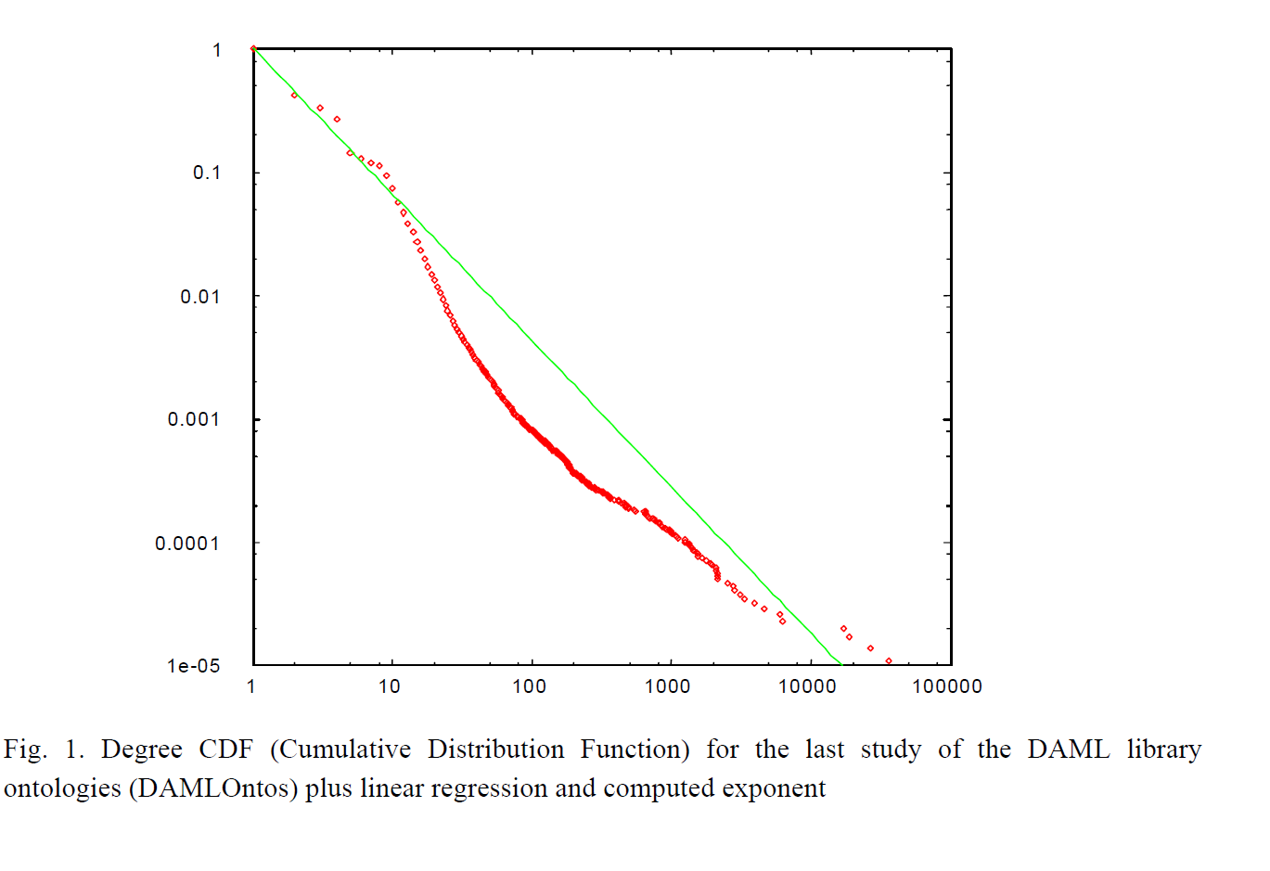
Scale free properties in DAML library ontology

Slide 21
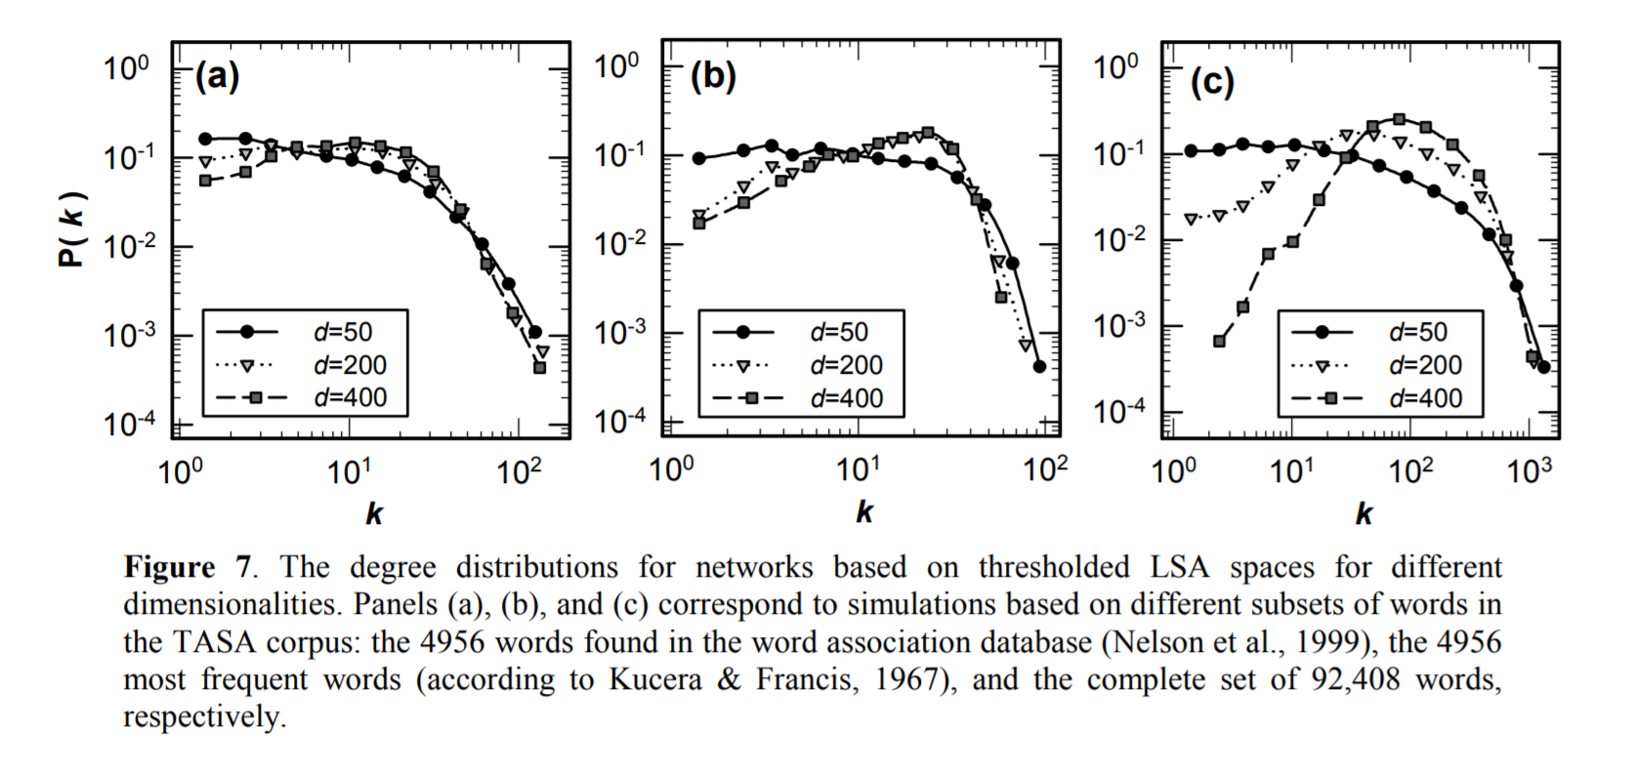
Dynamic Network scale free properties
Using thresholded Latent Semantic Analysis similarity

Slide 22
Problems
“The LSA networks look less plausible when the degree distribution are plotted”
“LSA and related co-occurrence-based models of meaning may need to be revised in some way. The appropriate revision may be an extension, such as adding some kind of dynamic growth process based on differentiation, or a more radical step, such as replacing the relatively unstructured, isotropic representational substrate of a Euclidean vector space with some more structured framework, such as a network.”

Slide 23
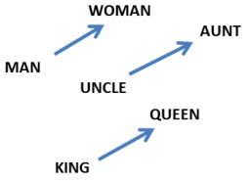
Word Embeddings
Word2Vec: A shallow two layer neural network trained to reconstruct linguistic context.
Input: a large corpus of text
Output: a vector space, typically of several hundred dimensions
W(‘‘cat")=(0.2, -0.4, 0.7, ...)
W(‘‘mat")=(0.0, 0.6, -0.1, ...)
Remarkable properties:
Analogy:
W(‘‘woman")−W(‘‘man") ≃ W(‘‘aunt")−W(‘‘uncle")
W(‘‘woman")−W(‘‘man") ≃ W(‘‘queen")−W(‘‘king")

Slide 24
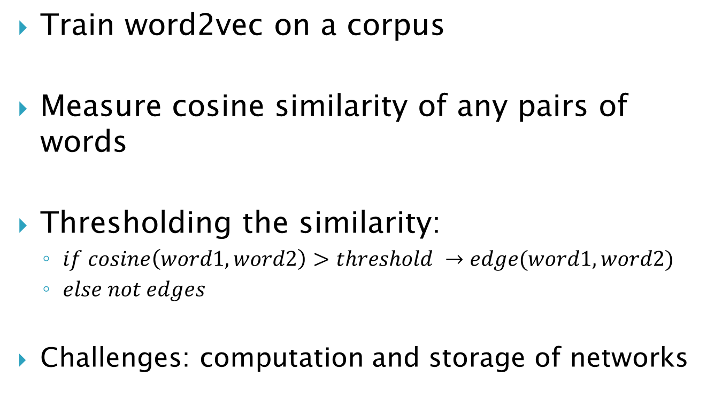
Complex networks of word2vec
Train word2vec on a corpus
Measure cosine similarity of any pairs of words
Thresholding the similarity:
$if cosine\left(word1, word2\right)>threshold →edge(word1, word2)$
$else not edges$
Challenges: computation and storage of networks

Slide 25
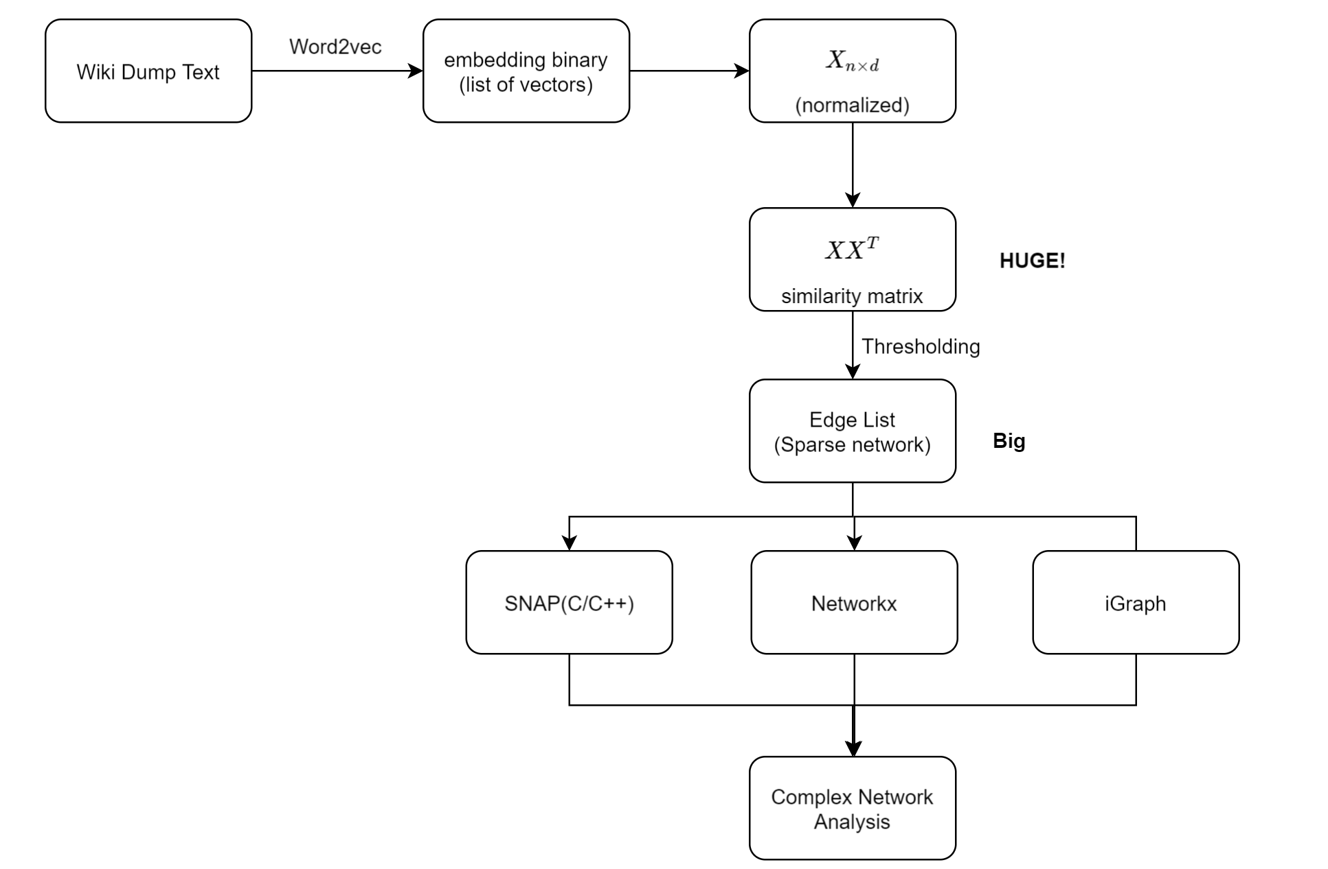
Implementation

Slide 26
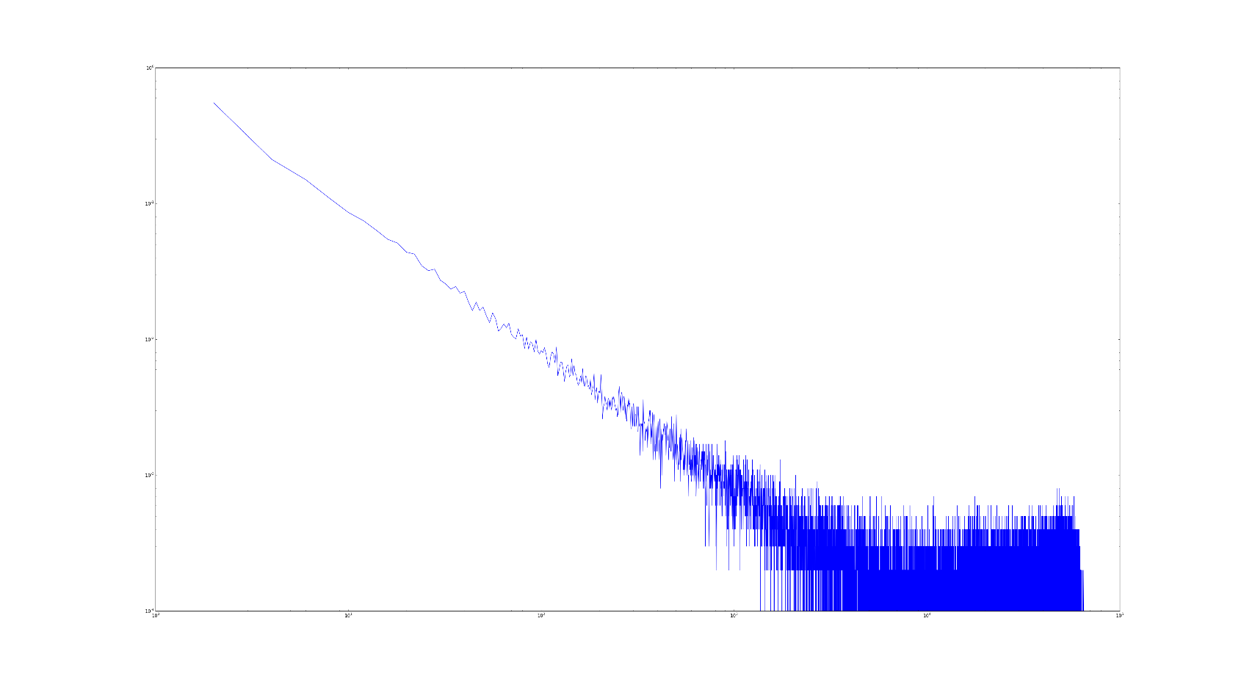
Results
Degree distribution
On 70k sample of English Wikipedia (threshold=0.6)

Slide 27
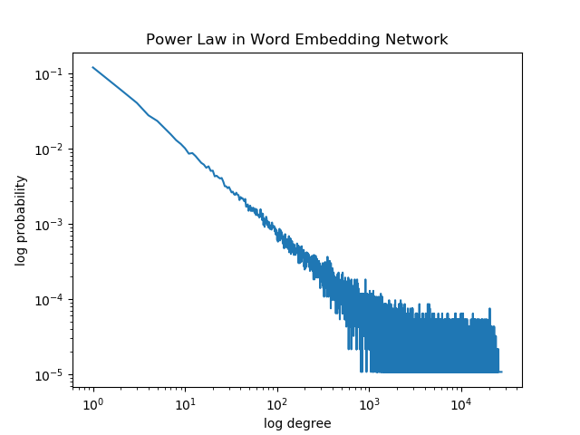
Results
On Whole Persian Wikipedia (154K tokens)
Threshold=0.75

Slide 28
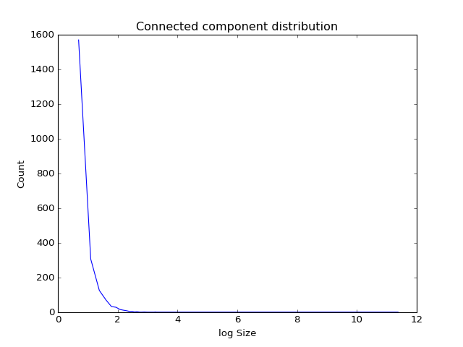
Results
Clustering coefficient: 0.5983>>0.00023(random network with the same size)
Diameter: 12
Connected component distribution

Slide 29
Technologies
Pycuda to store matrix in GPU
Skcuda(scikit-cuda) for computing matrix multiplications(BLAS optimized code)
HDF5 for storing large matrices on disk (designed to store and organize large amounts of data. )
My laptop
Nvidia GeForce GTX 860M 4GB
16 GB RAM
Intel® Core™ i7-4710HQ 2.50GHz

Slide 30
Future works
Show the results for all English words and other languages to show it as a universal property
Use other embedding words like SENNA, Turian and eigenwords
Find the communities(clusters) in the network of words
Extend the idea to sentences and documents. Documents can be represented as a network of sentences(sent2vec)

Slide 31
Future works(Applications)
Use Clustering coefficient and betweenness as features for different nlp tasks like text classification
de Arruda, H. F., Costa, L. D. F., & Amancio, D. R. (2016). Using complex networks for text classification: Discriminating informative and imaginative documents. EPL (Europhysics Letters), 113(2), 28007.
WSD:
Silva, T. C., & Amancio, D. R. (2012). Word sense disambiguation via high order of learning in complex networks. EPL (Europhysics Letters), 98(5), 58001.
Language clustering
Liu, H., & Cong, J. (2013). Language clustering with word co-occurrence networks based on parallel texts. Chinese Science Bulletin, 58(10), 1139-1144.
Topic modeling
Gerlach, M., Peixoto, T. P., & Altmann, E. G. (2017). A network approach to topic models. arXiv preprint arXiv:1708.01677.
And many other applications

Slide 32
Thank you
Thank you
Thank you

